Slide 1
Chirag Arora
ML Deployment

Slide 2

User Requirement
Data scientist has asked to deploy any selected model and deploy it on AWS instance using any pre-installed AMI image. Also write the HTTP server to handle the requests to analyze the image against the model.

Slide 3
Model Selection
Tiny Yolo V2
Its really tiny so it can fit in a container
Not that accurate, but given micro VM, this was the best model for deployment.
Pre-trained on VOC data set with 19 labels. Motive : Object detection to compare with science team

Slide 4
Framework
DL4j – Deep Learning 4J backed by ND4J for tensors / matrix multiplication.
Deeplearning4j is as fast as Caffe for non-trivial image recognition tasks using multiple GPUs
Easy to integrate with Java / Scala systems.

Slide 5
HTTP Server (Microservice)
Proton – Reuse of microservice framework. Inspired by Nike Ripostle and Netflix Governator
Image classification service

Slide 6
Microservice

Slide 7
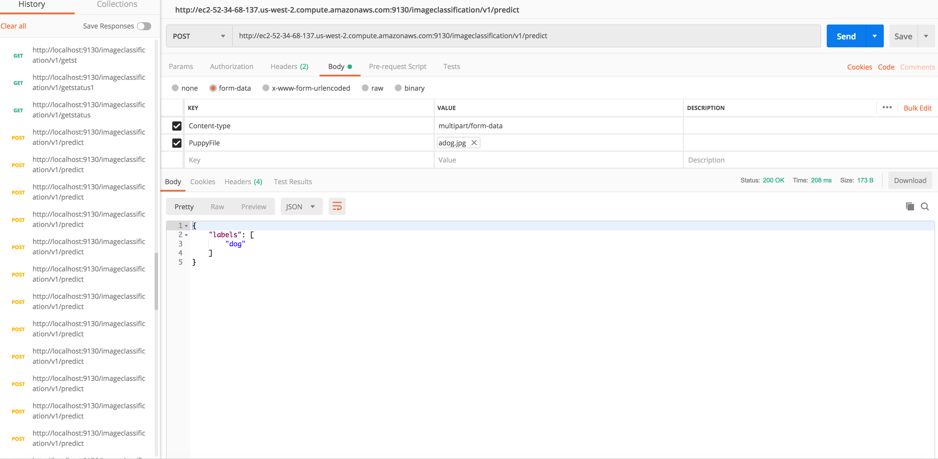
/predict
File and header in the POST request
Response consists of all the labels.

Slide 8
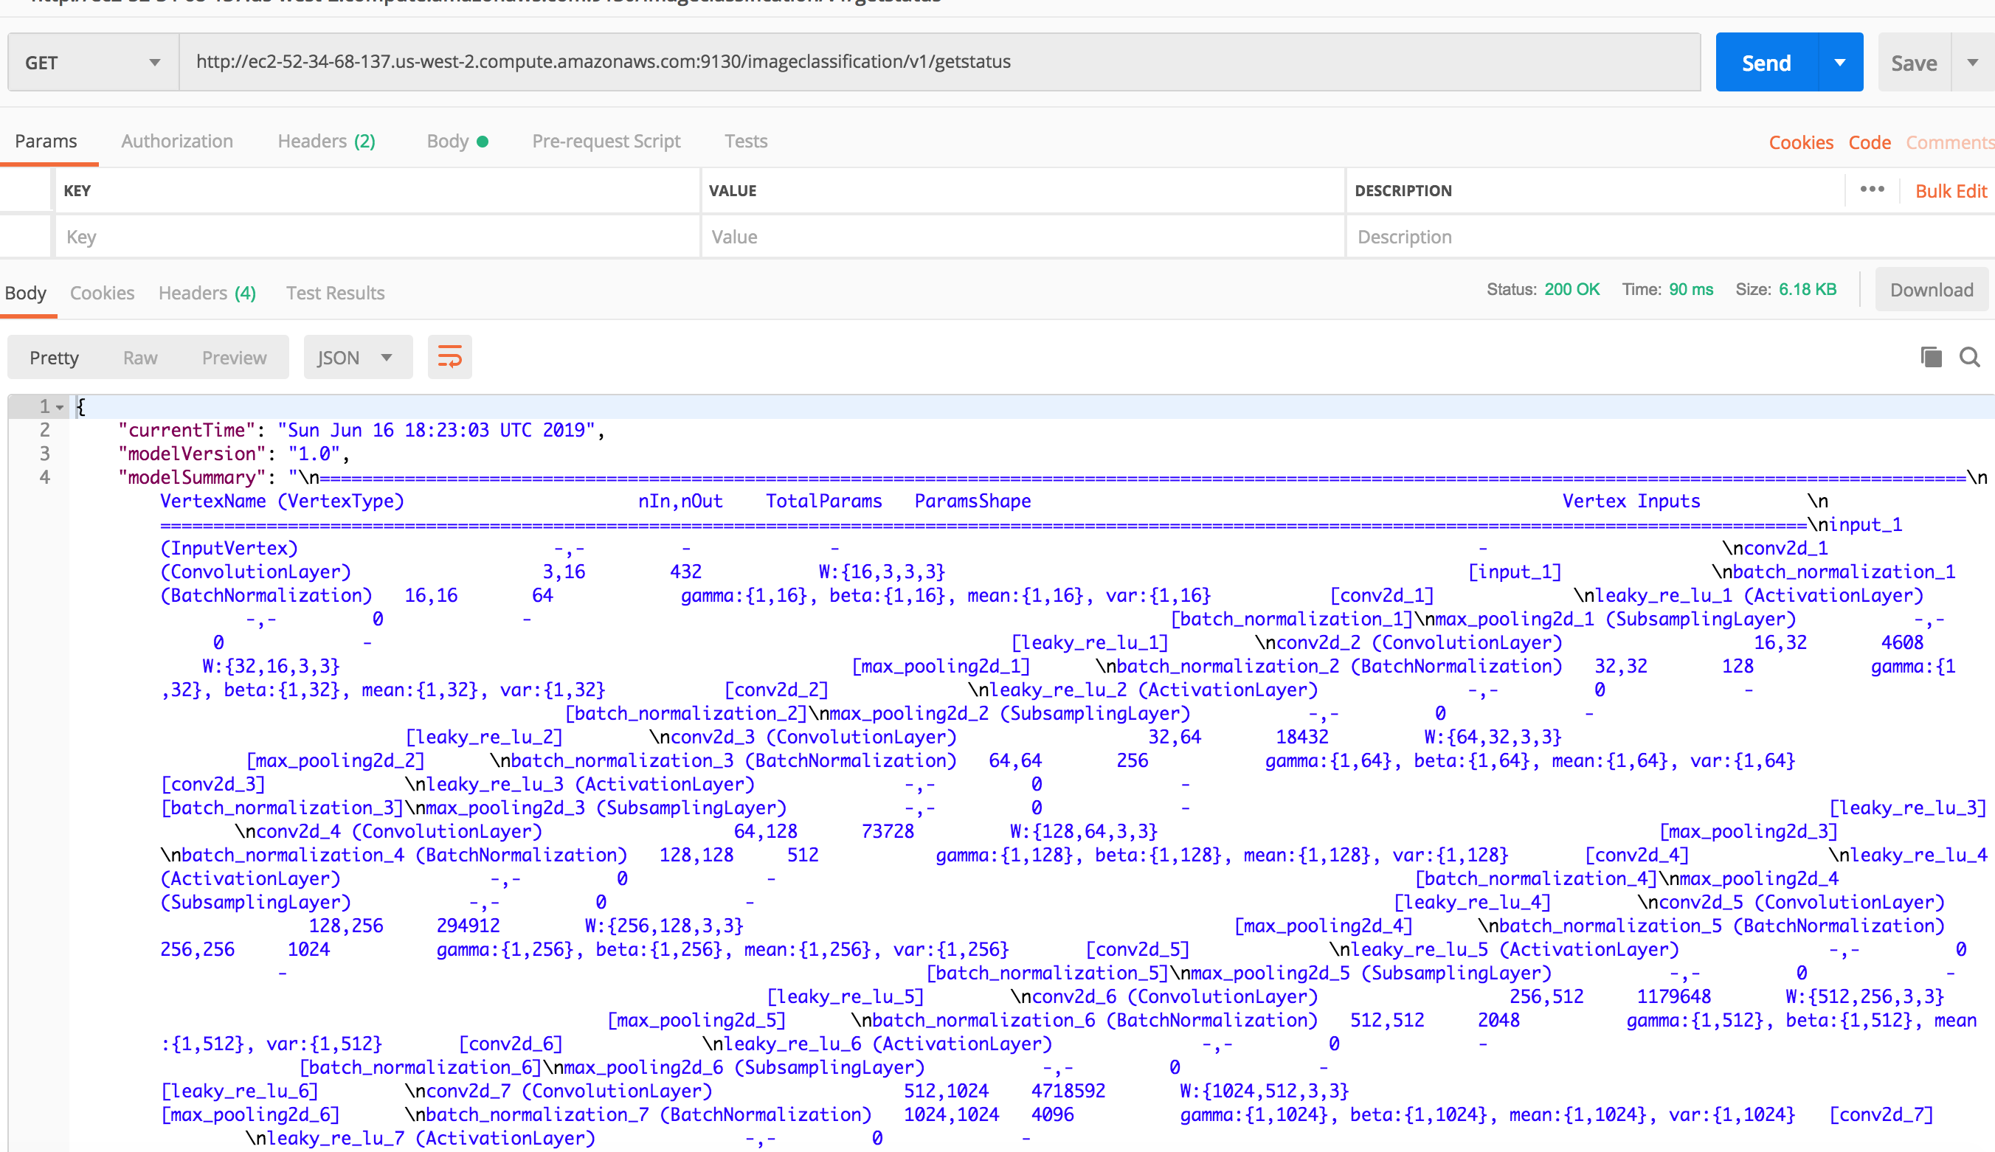
/getstatus - Summary of the model - networks and its weights - Version number - Current Time

Slide 9
Thank You

